Slide 1
SRSU Faculty & Staff Title IX Training
October 21, 2024
Espino Conference Center
1130 AM – 1 PM
Presented by Katrina Cano & Katy Williams
Notes:
Welcome all to this Title IX training for SRSU Faculty & Staff. My name is Katrina and I am the Title IX Coordinator. Katy Williams and I will be conducting this Title IX training today. There are four points of housekeeping before we begin:
Recording is in progress – You should be aware that this teams meeting is being recorded, and will be posted on a Title IX SRSU Info Page, for later reference. The Power Point will also be made available online.
To those joining online, please be aware that the room is not set up for us to hear people joining remotely. If you are joining online and would like to ask a question or make a point during today's training, please write a message in the Microsoft Teams chat.
We are passing around sign up sheets. Please sign the sheet. We will collect names of those attending online. We will share all who are attending with HR to count this training towards your HR and Professional Development credit.
The final note is a trigger warning- Some of the terms or descriptions used in this training could cause uncomfortable associations. If you feel at any time you need a break from the training, please take one.
Now that the housekeeping is out of the way >> I want to first ask what about Title IX do you want to learn more about? You can shout it out and I'll take a note, as your suggestions could be integrated into future Title IX information sessions or trainings.

Slide 2
Title IX
Title IX states, “No person in the United States shall, on the basis of sex, be excluded from participation in, be denied the benefits of, or be subjected to discrimination under any education program or activity receiving Federal financial assistance.”
Notes:
First! What is Title IX?
Read slide
The U.S. Department of Education’s Office for Civil Rights (OCR) enforces, Title IX.
This training is on Title IX.

Slide 3
From our Student’s Title IX Presentation
Notes:
The scope of Title IX is broad, as can be seen from this graphic Katy presented before which highlights the different Title IX components. This particular training on Title IX is scoped in on the particular aspect of Sexual Misconduct for Title IX training.

Slide 4
Title IX Training Objectives
What are my Title IX responsibilities?
What is the Title IX procedure?
What do student know about Title IX?
Notes:
Here are our objectives for today's Title IX training.
We will clarify what your Title IX responsibilities are as a Sul Ross employee
We will discuss the Title IX procedure, here at Sul Ross
We will share what Sul Ross students should know about Title IX
At the end of our presentation, you will be asked to complete an evaluation based on these objectives. I suggest you take notes under these three headers through the presentation, to prepare for that evaluation.
I'll give you a moment to write down these three objectives for our training today.

Slide 5
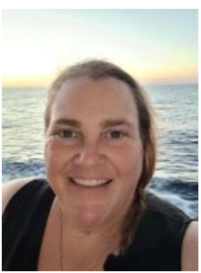
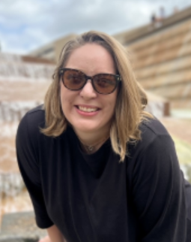
SRSU's Title IX Team
Katrina Cano
Title IX Coordinator
University Center 212
432-837-8892 katrina.cano@sulross.edu
Dr. Suzanne Harris
Title IX Decision Maker
University Center 211
432-837-8255
sharris@sulross.edu
Katy Williams
Title IX Investigator
Ferguson 108
432-837-8596 katy.williams@sulross.edu
Notes:
So then! Now for formal introductions to the Title IX team here on SRSU's campus.
There are three of us who play a central role in the Title IX process on campus.
Dr. Harris, the Dean of Students, is our Title IX Decision Maker, if a Title IX investigation goes to a live hearing.
We will share further information on her role later in this presentation.
Again, my name is Katrina Cano, and I am the Title IX Coordinator.
What is a Title IX Coordinator?
As the Title IX Coordinator, I:
receive allegations of sexual misconduct on campus, intake involved parties and manage cases.
I also share information on the Title IX process with those involved in an incident, and the broader university community
Now I’ll turn the floor over to Katy Williams - so she can introduce herself and share on her role with Title IX at Sul Ross.
Katy introduces herself

Slide 6
Revised Agenda
40-minute presentation
20-minute discussion on scenarios
10-minute evaluation
20-minute Q&A
Notes:
Great, thank you Katy.
Read slide
Please note down questions through the presentation for the Q&A session.

Slide 7
From our Student’s Title IX Presentation
Notes:
With that, let's begin.
Again – Title IX is concerned with protecting people from discrimination based on sex in educational programs receiving federal funding
Today we are focused on the sexual misconduct aspect of Title IX
Beyond Title IX, there are additional federal laws which Sul Ross is obligated to comply with that overlap with the particular issue of sexual misconduct.

Slide 8
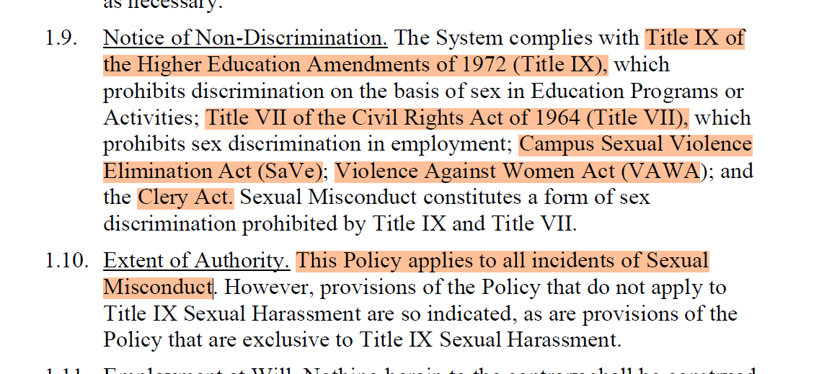
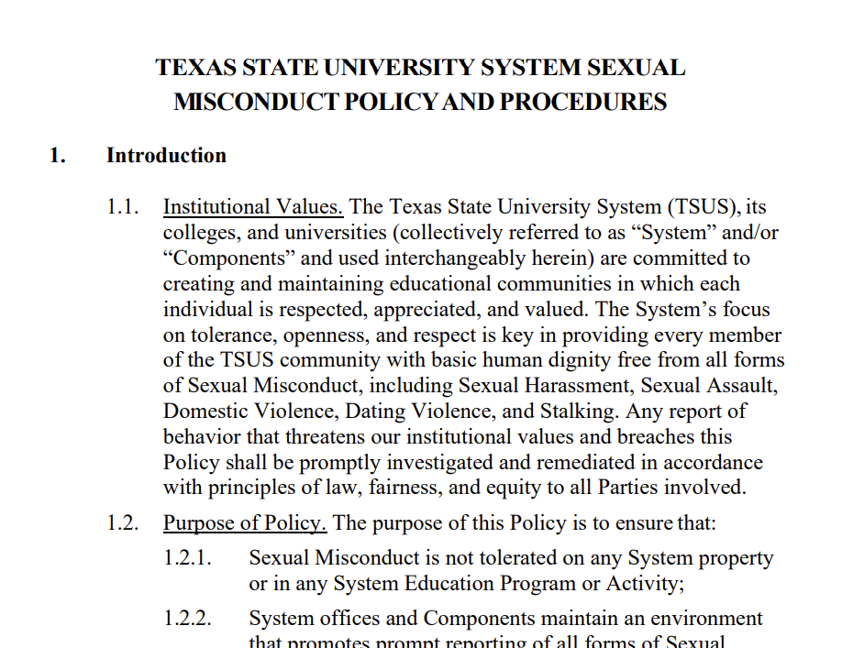
Clery Act & VAWA
Campus SaVE Act
Title VII & Title IX
Notes:
On this slide we can see how Title IX and other laws come together in the Texas State University System Sexual Misconduct Policy and Procedures.
It is this policy which we are discussing today.
As a reminder, this TSUS Sexual Misconduct Policy was included in the agenda of this meeting, and can also be found by following the website in the Power Point’s footnote.

Slide 9
https://bjs.ojp.gov/content/pub/pdf/rsavcaf9513.pdf
Notes:
This infographic is based on 2014 statistics from the Department of Justice.
Sexual violence on campus is pervasive.
13% of all students experience rape or sexual assault through physical force, violence, or incapacitation
Among undergraduate students, 26.4% of females and 6.8% of males experience rape or sexual assault through physical force, violence, or incapacitation
5.8% of students have experienced stalking since entering college.2

Slide 10
From our Student’s Title IX Presentation

Slide 11
From our Student’s Title IX Presentation

Slide 12
From our Student’s Title IX Presentation

Slide 13
From our Student’s Title IX Presentation

Slide 14
From our Student’s Title IX Presentation

Slide 15
From our Student’s Title IX Presentation
(TSUS Sexual Misconduct Policy and Procedures p 52-53)

Slide 16
From our Student’s Title IX Presentation

Slide 17
From our Student’s Title IX Presentation
(TSUS Sexual Misconduct Policy and Procedures p 59-60)

Slide 18
From our Student’s Title IX Presentation
(TSUS Sexual Misconduct Policy and Procedures 3, p 3-13)

Slide 19
From our Student’s Title IX Presentation
(TSUS Sexual Misconduct Policy and Procedures 3, p 3-13)

Slide 20
From our Student’s Title IX Presentation

Slide 21
Sexual Misconduct
Sexual Misconduct – a broad term encompassing a range of non-consensual sexual activity or unwelcome behavior of a sexual nature (TSUS Sexual Misconduct Policy, p. 59)
"Responsible Employee" Faculty/Staff
Notes:
As Katy shared earlier, in the Texas State University System's Sexual Misconduct Policy and Procedures, Sexual Misconduct is --- read slide
Since this training is geared to SRSU Faculty and Staff, the important word today is "Responsible Employee"

Slide 22
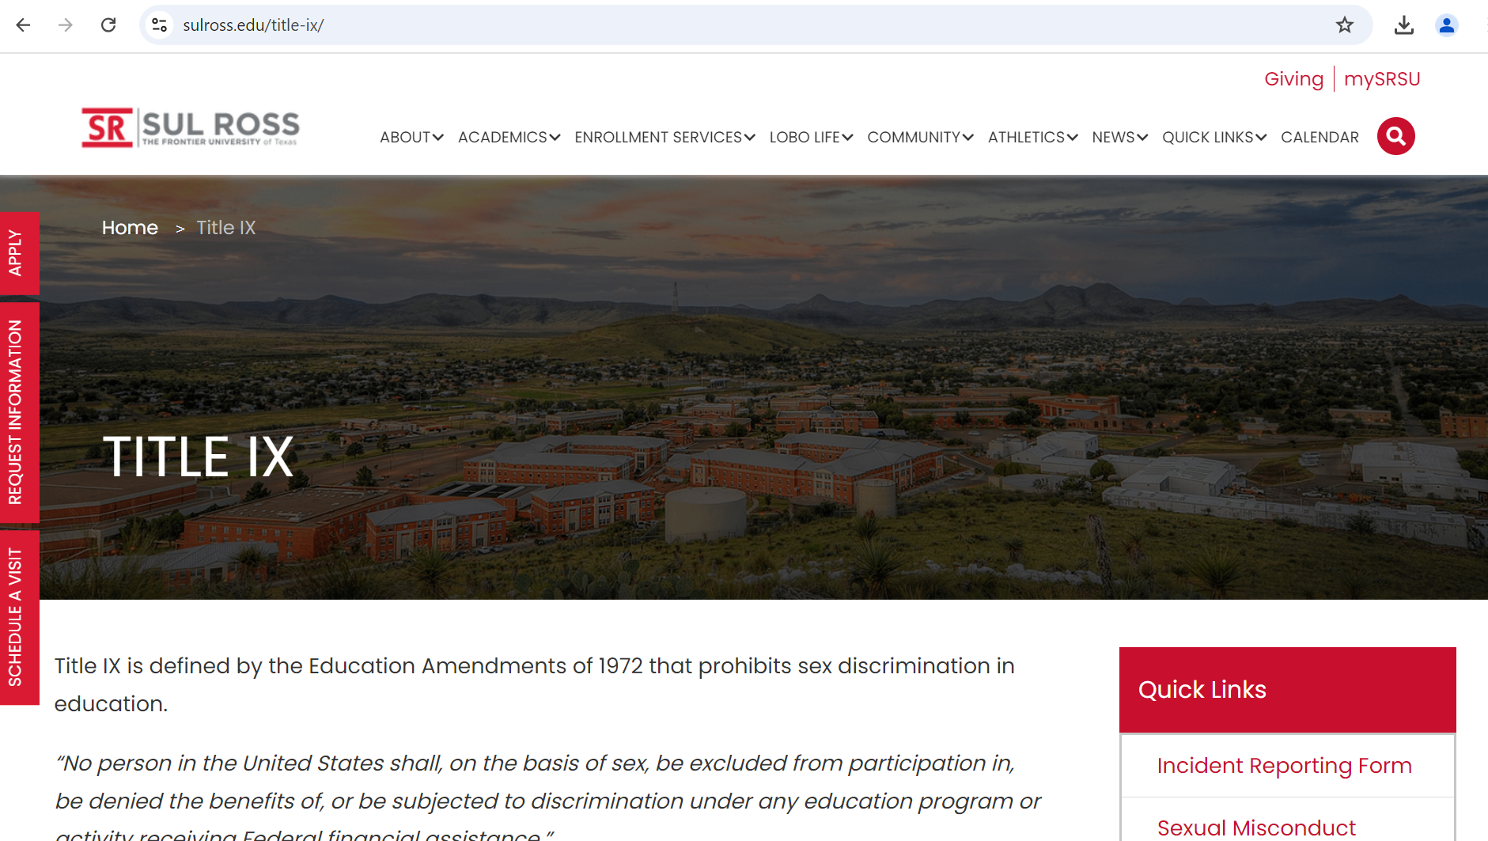
Reporting Incidents of Sexual Misconduct
"Responsible Employee" Faculty/Staff
Title IX Coordinator
Confidentiality
Notes:
How to report
We will notify you we received your report, but you will not receive further information on the case beyond that.
Confidentiality - all involved in an alleged Title IX case have a right to confidentiality
You will not be notified of updates on the case

Slide 23
Terminology - Title IX Incident
Confidentiality
"Parties"
Complainant
Respondent
Advisor
Advisor
Notes:
Confidentiality
Parties (means the complainant and respondent)
Complainant
Individual who is alleged to be the victim of sexual misconduct
Respondent
Refers to the person accused of sexual misconduct
Advisor
Person who may accompany the Party to any and all meetings, hearing, or proceedings and provides supports, guidance, or advice to the party.

Slide 24
Scenarios
"Responsible Employee" Faculty/Staff
Confidentiality
"Parties"
Complainant
Respondent
Advisor
Advisor
Notes:
20 minutes – scenarios

Slide 25
Title IX Training Evaluation
Scan the QR code to answer questions about content covered in this training.
Notes:
10 minutes for evaluation

